Slide 1
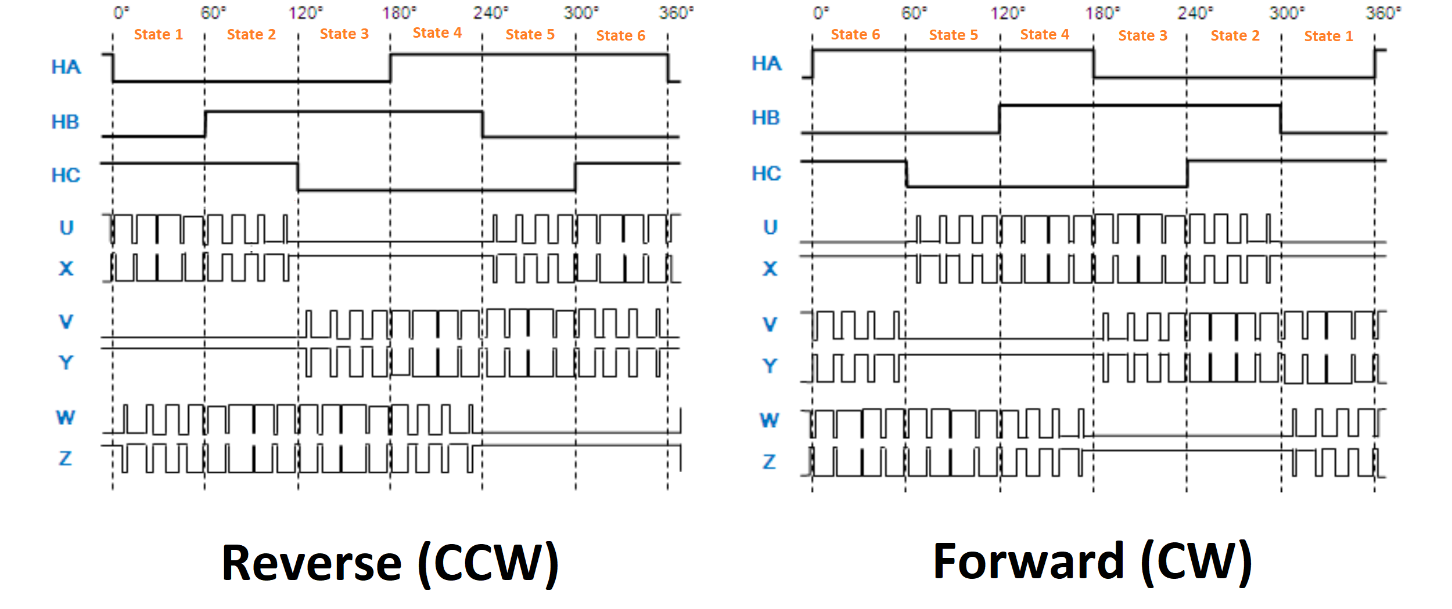
Pattern 2
Pattern 3
Pattern Lo
Pattern Lo
Pattern 0
Pattern 1
Pattern Lo
Pattern 0
Pattern 1
Pattern 2
Pattern 3
Pattern Lo
Pattern Lo
Pattern Lo
Pattern 0
Pattern 1
Pattern 2
Pattern 3
Pattern 3
Pattern Lo
Pattern Lo
Pattern 0
Pattern 1
Pattern 2
Pattern 0
Pattern 1
Pattern 2
Pattern 3
Pattern Lo
Pattern Lo
Pattern 1
Pattern 2
Pattern 3
Pattern Lo
Pattern Lo
Pattern 0

